Slide 1
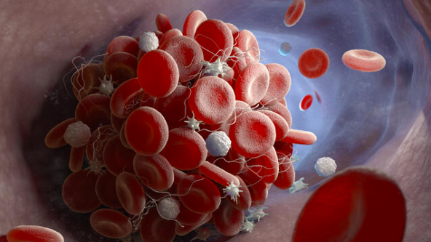
Venous
Thromboembolism
Chrissy McCain MSN, RN

Slide 2
Perfusion Concepts: Venous Thromboembolism
Concept focus: impaired perfusion due to vascular occlusion
** Objectives: By the end of this learning experience, the student will be able to:
1. Describe the pathophysiology of venous thromboembolism and its effects on blood flow and tissue perfusion.
2. Identify assessment findings and diagnostic data associated with deep vein thrombosis and pulmonary embolism.
3. Differentiate between the clinical manifestations of deep vein thrombosis and pulmonary embolism.
4. Apply appropriate nursing interventions for patients experiencing venous thromboembolism to prevent complications and promote perfusion.
5. Analyze patient responses to anticoagulation therapy and other treatments for venous thromboembolism to support clinical judgment.

Slide 3
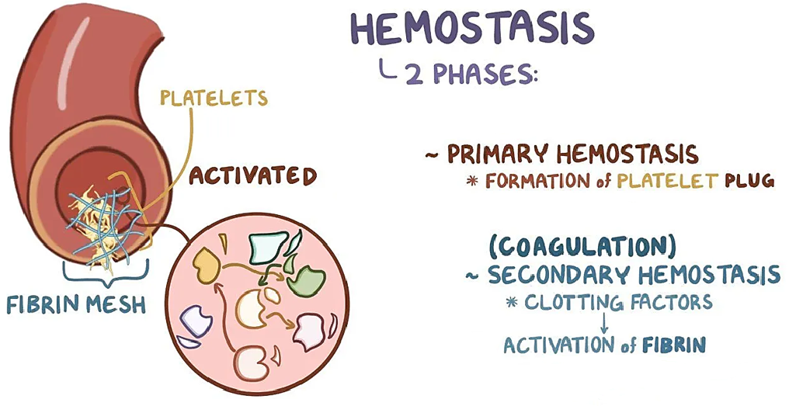
Hemostasis – AKA - Blood Clotting Overview
(Get Ready!! We’re going to understand all this together!!)

Slide 4
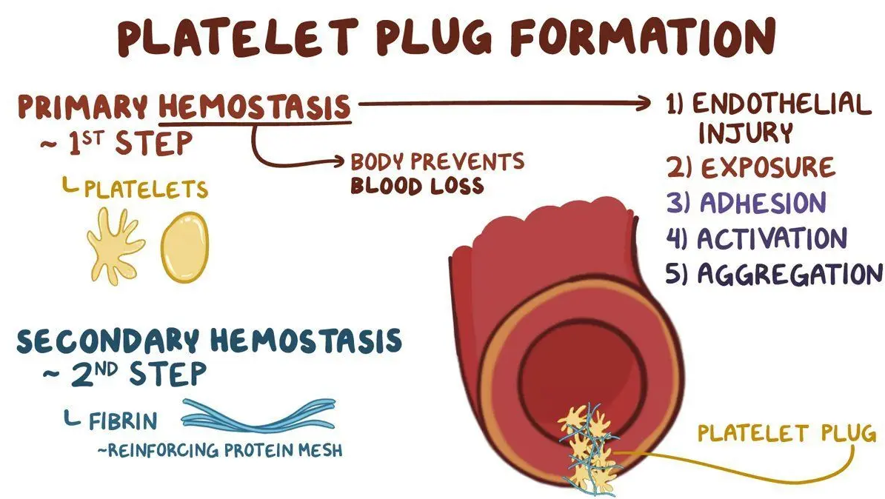
PRIMARY HEMOSTASIS: Formation of Platelet Plug
Endothelial injury causes vaso-constriction (to slow blood flow for platelets and allow clotting factors to respond)
Platelets make temporary plug/patch that stops bleeding right away
Then the coagulation cascade is initiated…

Slide 5
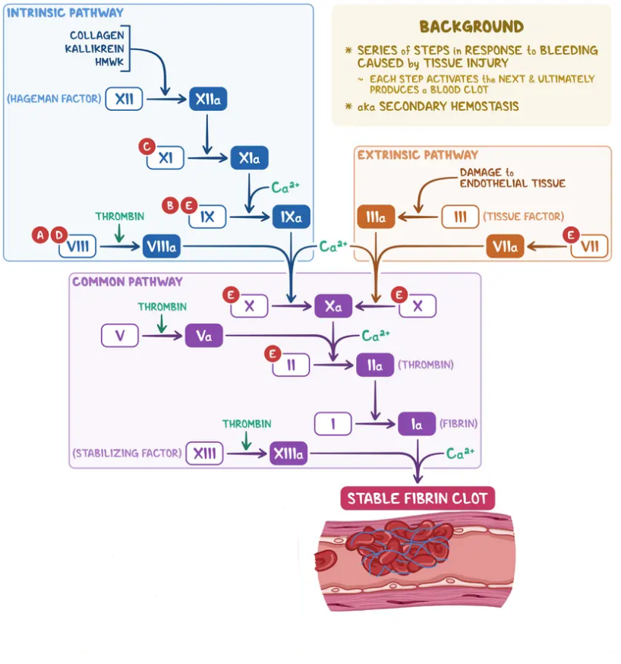
SECONDARY HEMOSTASIS:
Coagulation
This process is Initiated by 2 Different Pathways:
Intrinsic Pathway: trauma inside vessel (contact activation)
Extrinsic Pathway: external trauma that causes blood to leave vessel & release tissue factor
Then the Common Pathway
Stabilizes the fibrin clot
During this clotting cascade, clotting proteins make fibrin net that holds platelet plug/patch together like glue to stabilize the clot

Slide 6

FIBRINOLYSIS:
Clot Breakdown:
Plasmin acts like a puppy chewing threw the fibrin mesh to break down the clot once the blood vessel is healed
This process releases D-Dimer proteins
Also prevents excessive clot formation

Slide 7
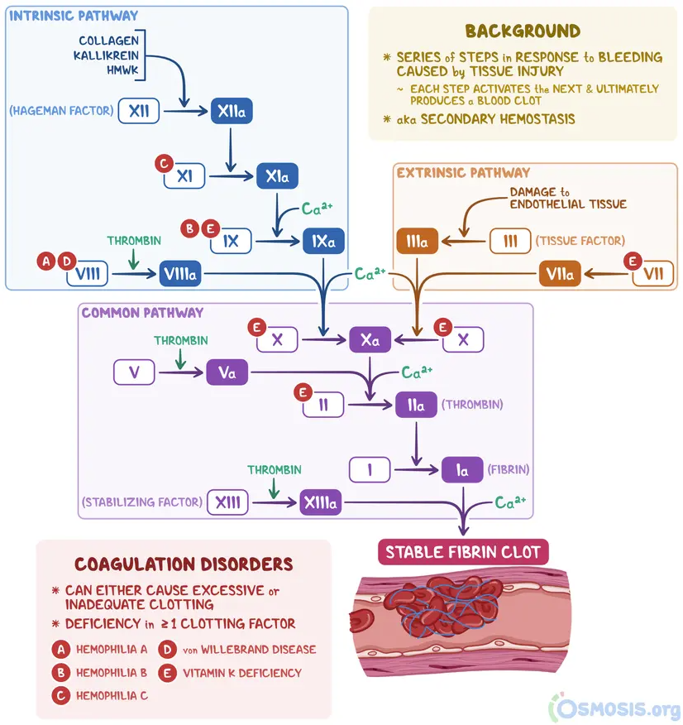
Hemostasis (Blood Clotting) 101:
1.) PRIMARY HEMOSTASIS: Formation of Platelet Plug
  1a.) Endothelial injury → Vasoconstriction (to slow blood flow for platelets and clotting factors to respond)
  1b.) Platelets make temporary plug/patch that stops bleeding right away
2.) SECONDARY HEMOSTASIS: Coagulation
  During clotting cascade, clotting proteins make fibrin net that holds platelet plug/patch together like glue to stabilize the clot
This process is Initiated by 2 Different Pathways:
Intrinsic Pathway: trauma inside vessel (contact activation)
Extrinsic Pathway: external trauma that causes blood to leave vessel & release tissue factor.
3.) FIBRINOLYSIS: Clot Breakdown:
Plasmin acts like a puppy chewing threw the fibrin mesh during “fibrinolysis” once the vessel is healed (this is also release D-Dimer proteins we’ll talk about later!) This process prevents excessive clot formation.

Slide 8
COAGULATION… What you need to know/understand:
Anticoagulants work at different levels of the process & we monitor labs that check the speed of coagulation accordingly.
Heparin –
  • Works fast to slow the clotting process!
  • Slows the speed of clotting in the intrinsic pathway ~&~ also thrombin/fibrinogen/fibrin steps in the common pathway
  • Antidote to reverse: Protamine sulfate
  • Lab to monitor: aPTT
Coumadin –
  • Works slower (this is why we bridge with Heparin/Lovenox)
  • Slows the speed of clotting in the extrinsic pathway & common pathway by blocking Vitamin K
  • Antidote to reverse: Vitamin K
  • Lab to monitor: PT/INR (INR more specifically)
  • Note: Must have consistent dietary intake of Vitamin K to ensure therapeutic effect. & Antidote Injection type depends on need/risk
NOTE: These are only a couple of examples of anticoagulants
😐
Don’t worry!!
Yes, this is an extensive process that is very in depth, BUT, as an RN, you don’t need to know every detail!

Slide 9
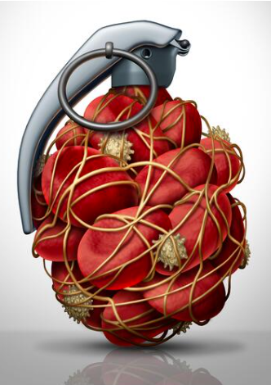
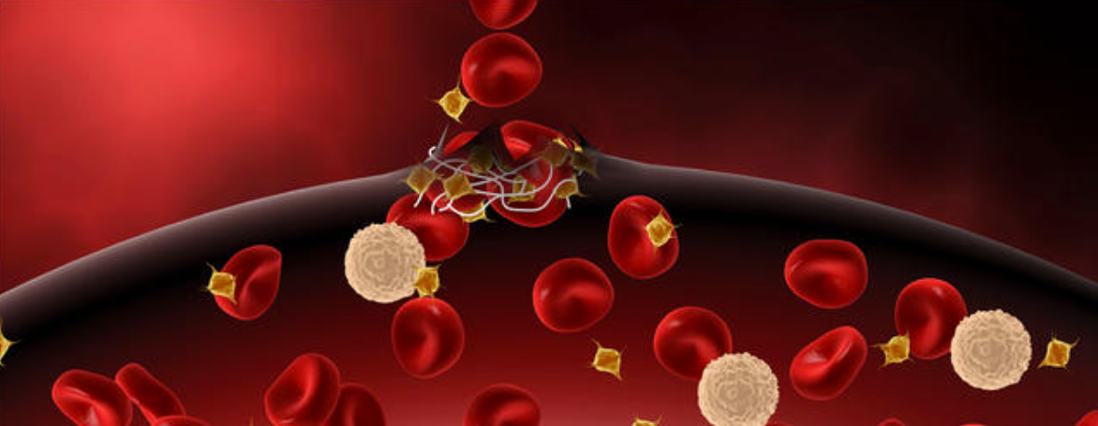
Venous Thromboembolism
Includes DVT (Deep Vein Thrombosis) and PE (Pulmonary Embolism)
Blood clot that forms in deeper veins
Ranges in severity. Can be managed outpatient with anticoagulants all the way to causing sudden death

Slide 10
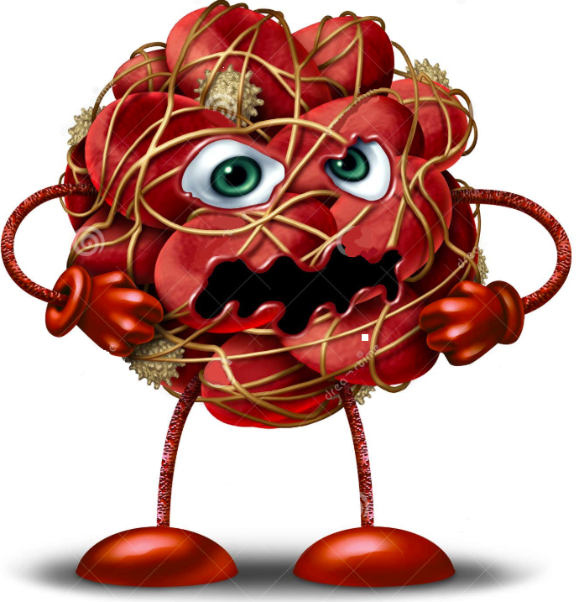
Virchow’s Triad
THREE CONTRIBUTING FACTORS
for pathologic blood clot formation:
#1 – Endothelial Injury: inner lining of blood vessel sustains injury
Trauma (surgery, fractures, catheter insert.)
Venous catheters (central line, long term IV)
Inflammation (atherosclerosis, sepsis…)
Chemo or radiation (damage)
#2 – Venous Stasis: blood flow altered
Prolonged immobility
Paralysis
Heart failure
Obesity
Pregnancy
Continued..

Slide 11
Virchow’s Triad
THREE CONTRIBUTING FACTORS
for pathologic blood clot formation
#3 – Hypercoagulable State where blood has increased tendency to clot (may be inherited or acquired factors)
Inherited:
Factor V Leiden mutation
Prothrombic gene mutation
Protein C, Protein S or antithrombin deficiency
Acquired:
Immobilization, prolonged bedrest
Severe infection, inflammation
Pregnancy, estrogen therapy (HRT, OCPs)
Malignancy
Antiphospholipid syndrome
Nephrotic syndrome
Obesity & smoking

Slide 12
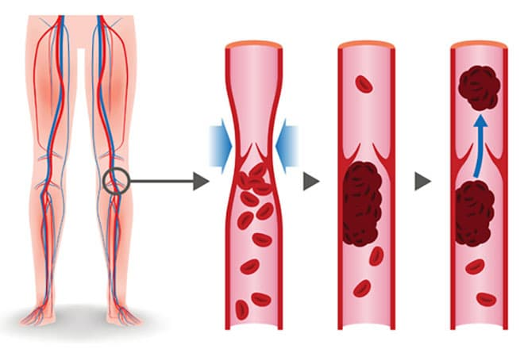
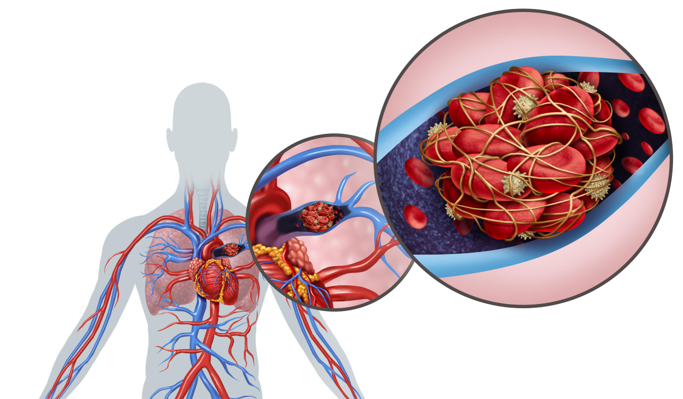
DVT vs. PE
DVT – Deep Vein Thrombosis
Etiology: Usually develops in deep veins of the legs
S&S: Pain, swelling, redness, warmth in one leg
Diagnostic: D-dimer, Ultrasound doppler
PE – Pulmonary Embolism
Etiology: Most often caused by DTV that “breaks free” & travels to the lungs
S&S: Sudden chest pain, dyspnea, anxiety, tachycardia, hemoptysis, vital sign changes
Diagnostic: CT Angiogram of lungs (most common), D-Dimer, V/Q scan, ABGs, EKG to rule out cardiac cause of chest pain

Slide 13
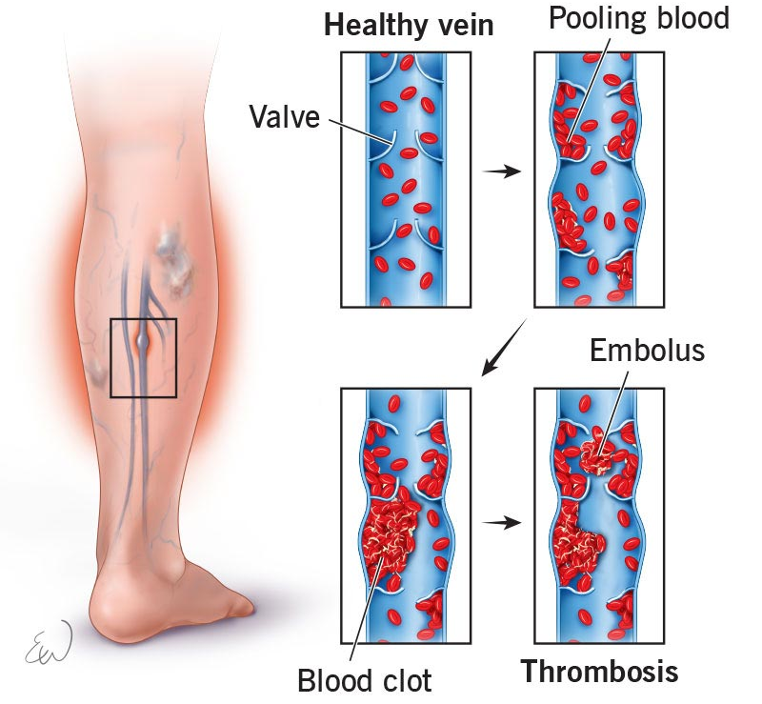
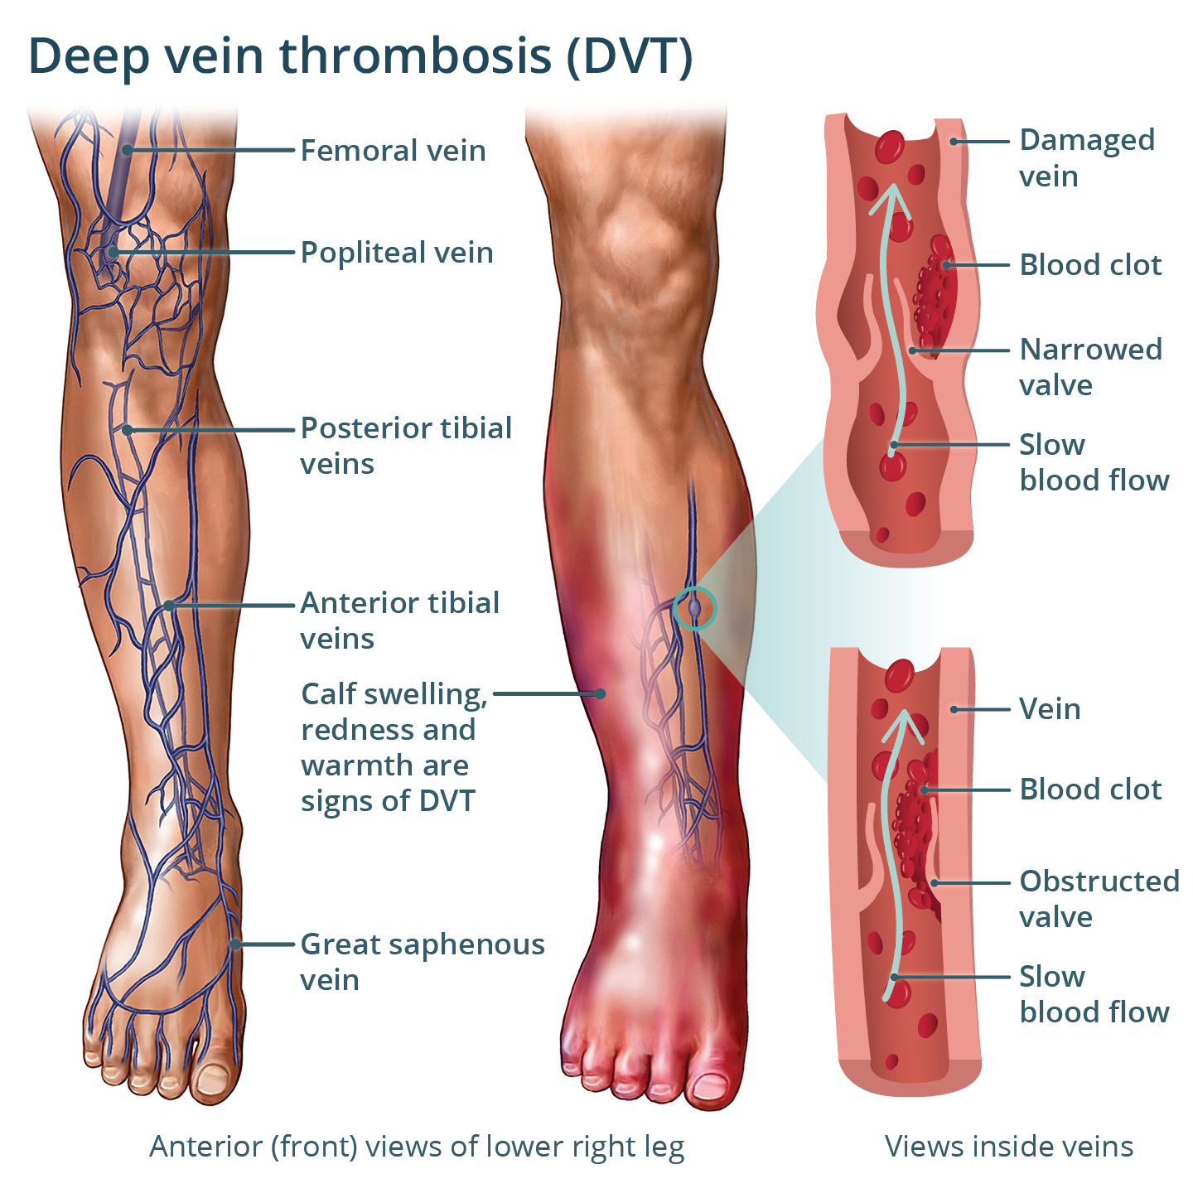
Deep Vein Thrombosis (DVT)

Slide 14
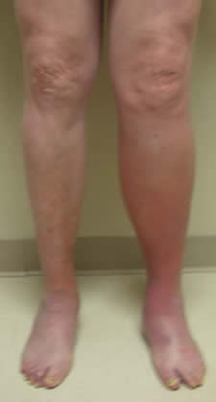
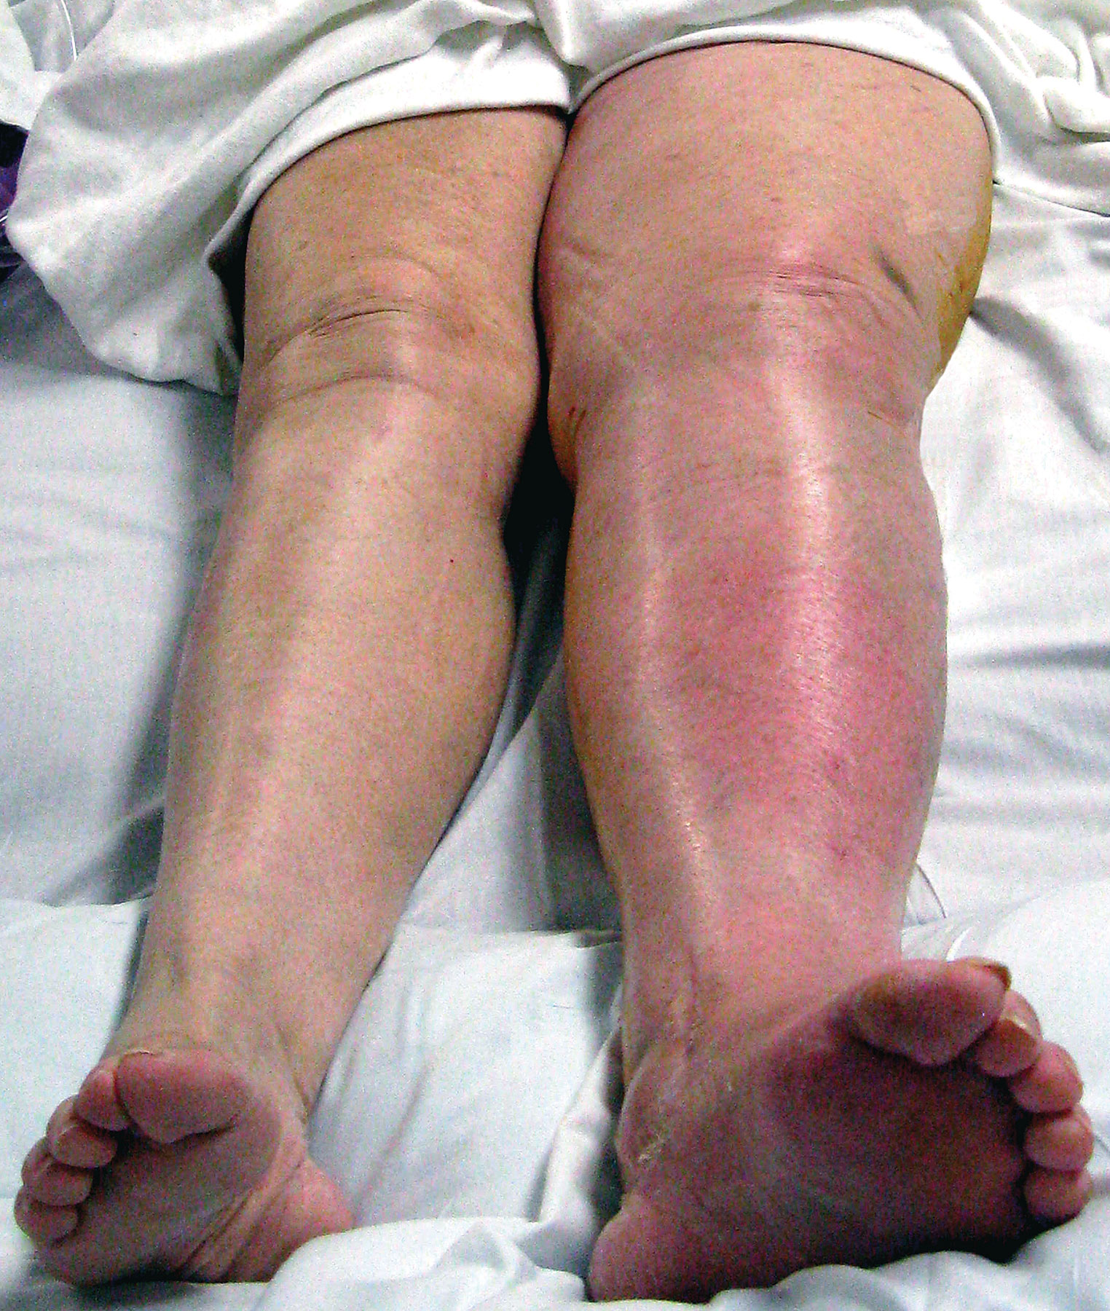

Slide 15
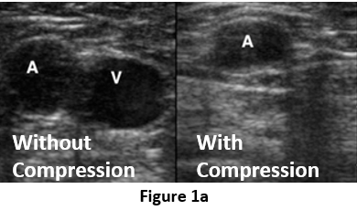
Diagnostic Ultrasound
Blood vessel is unable to be flattened when compressed during ultrasound due to a DVT in the lumen.

Slide 16
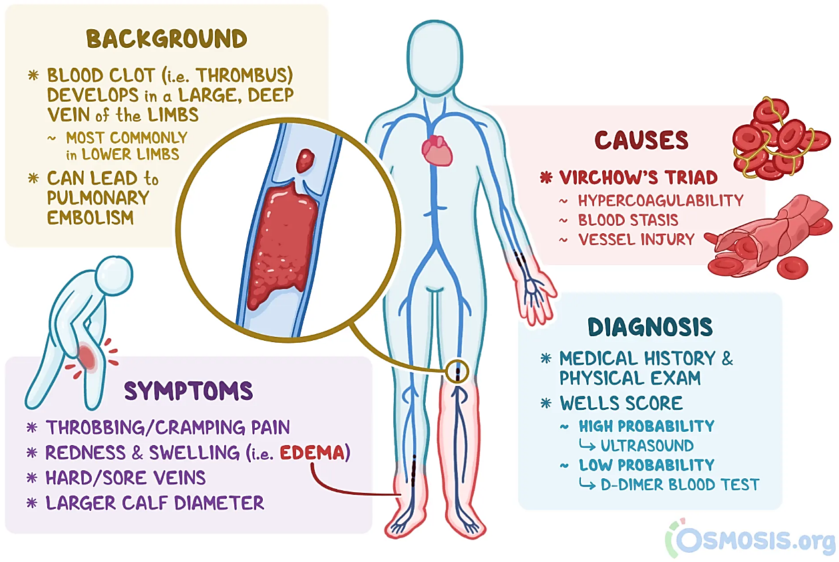

Slide 17
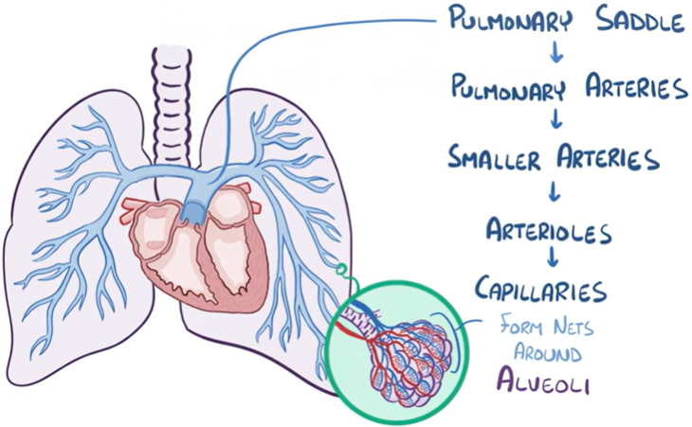
Blood flow from the heart through the vasculature of the lungs down to the alveoli where gas exchange occurs and blood becomes oxygen rich.

Slide 18
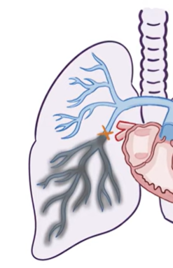
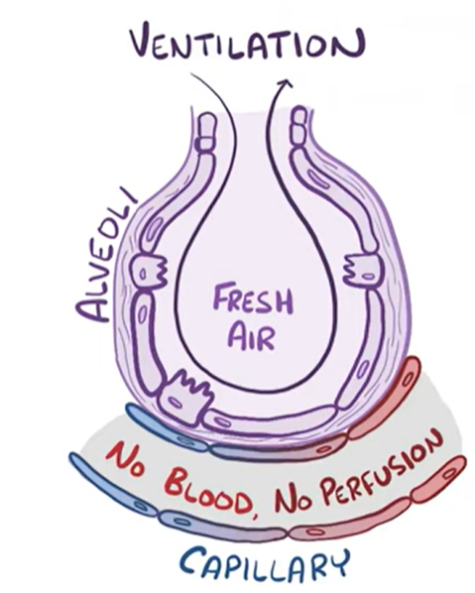
Pulmonary Embolism (PE)
When a blood clot blocks a vessel in the lungs cutting off blood flow and restricting gas exchange decreasing oxygenation of the blood.
Resulting in lower O2 in the blood and impaired oxygenation to lung tissue as well.
Most often only visible under CT scan.

Slide 19
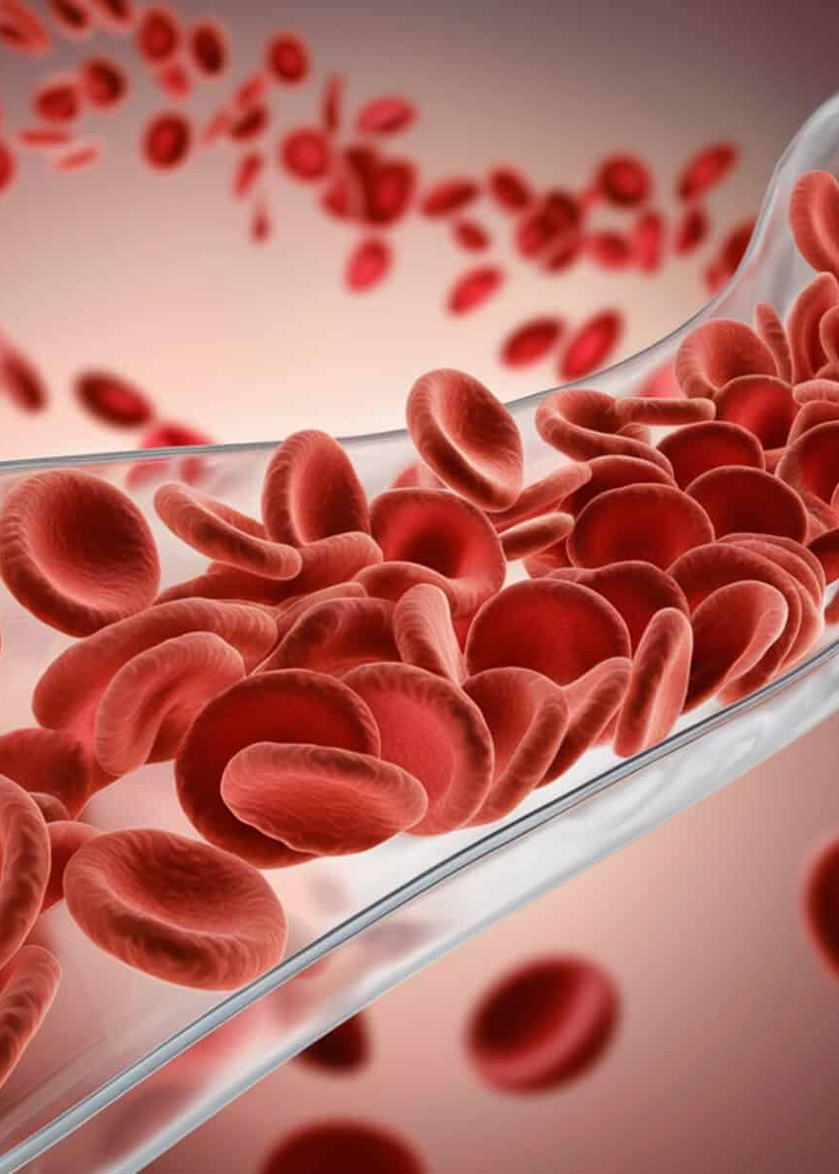
D-Dimer
What is it?
A protein fragment produced when a blood clot breaks down. (Remember the Plasmin Puppy chewing up the fibrin!) Note: It’s usually undetectable in the blood.
Why is it elevated?
Significant blood clotting:
DVT, PT, DIC, Stroke, Covid-19 infection
False Positives:
Advanced age, smoking, obesity, pregnancy, surgery, trauma, infections, heart disease, rheumatoid arthritis

Slide 20
Symptom Progression
DVT PE
Mild/Early:
• Dull, cramp-like pain often in calf/thigh
• Localized warmth
• Mild edema
• Redness, discoloration
Moderate:
• Increasing pain, hinders standing/ambulation
• Increased swelling
• Redness/purple discoloration
• Tight and heavy sensation
Severe:
• Extreme pain
• Significant swelling, taut & shiny skin
• Limb cyanosis
• Tachycardia, low-grade fever
If DVT dislodges, can move to lungs → PE.
PE can cause sudden cardiac death.
Mild/Early:
• Sudden onset SOB, DOE
• Pleuritic chest pain, Sharp & worse with inspiration
• Dry cough or mild hemoptysis
• Anxiety, feeling like something is wrong
Moderate:
• Tachypnea, tachycardia
• Decreased SPO2
• Dizziness, lightheadedness → syncope (r/t ↓perfusion)
• Worsened, more frequent hemoptysis
• Increased anxiety, feeling of impending doom
Severe:
• Severe dyspnea, oxygen hunger, cyanosis
• Extreme pain
• Hypotension, signs of shock
• Anxiety, confusion, sense of impending doom
• Diaphoresis → → • Cardiopulmonary Arrest
* Symptoms usually more severe with BOTH based on size/location of the clot. *

Slide 21
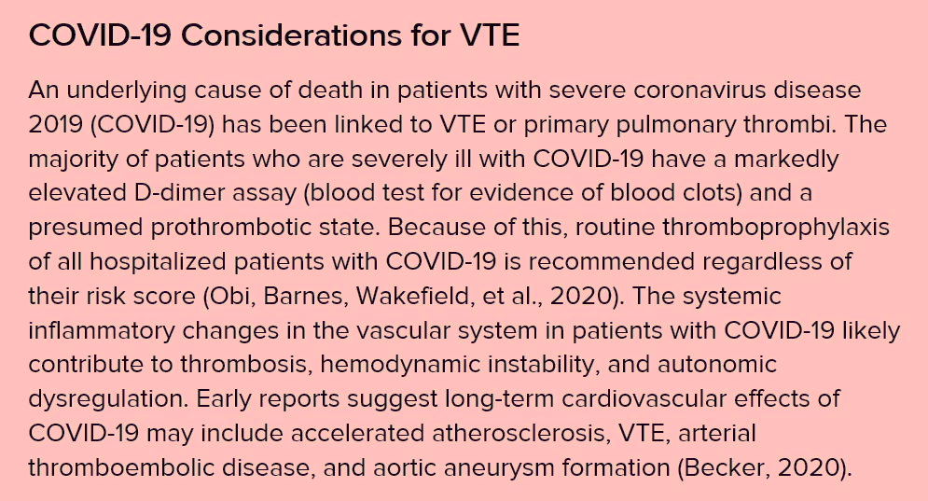

Slide 22
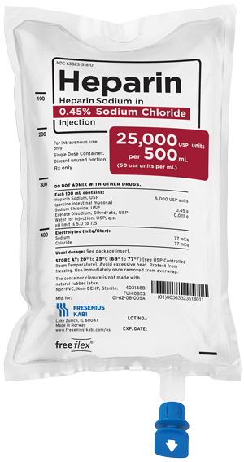
Medication Treatment
Acute, Hospital IV Therapy
IV Heparin: Rapid acting, immediate effect, inhibits clotting factors to stop clot from growing, PTT to monitor therapeutic dose (infrequently see SubQ Heparin is weight-based & Q12hrs) Antidote: Protamine sulfate
Thrombolytics (the clot busters!): actively dissolve the clot by breaking down fibrin, all through system so even the good plugs, widespread bleeding is huge risk, used in life-threatening cases & requires ICU monitoring

Slide 23
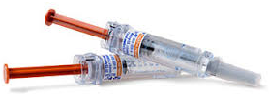
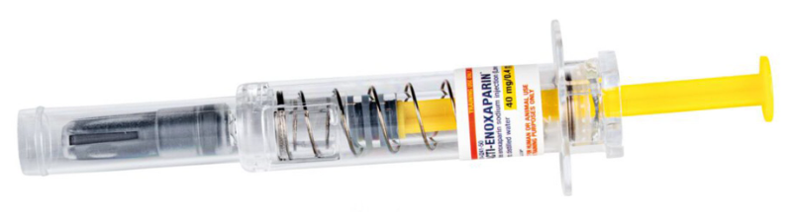
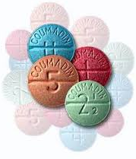
Medication Treatment
SubQ Bridging & PO therapy in hospital & transition to home
SQ Lovenox: (low-molecular weight Heparin) bridge for PO anticoagulation, safer for bridging and patients to use at home, works faster than Coumadin to anti-coagulate while waiting for therapeutic INR. Therapeutic dose is weight based, DVT prophylaxis is standard dose (usually 30mg blue or 40mg yellow 1x/day)
PO Warfarin (Coumadin): Prevents the liver from making certain clotting factors, long-term therapy requiring INR checks & awareness of diet & other medication considerations, Vitamin K agonist (& reversible with Vitamin K)
PO Direct Oral Anticoagulants (DOACs): Eliquis, Xarelto (there’s more). Directly inhibit clotting factors, quick onset, don’t need lab monitoring, less food/med interactions [[they ARE reversible, but much more expensive therapy (even with insurance!)

Slide 24
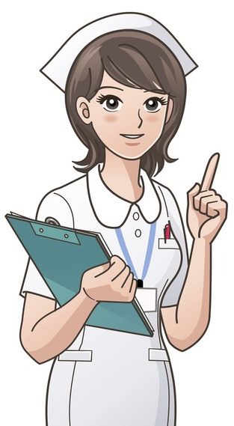
Nursing Management
Close Monitoring, Meds
Ensure IV Access: standard in hospital, consider 2nd IV expecting IV Heparin
Monitoring: Vitals especially O2, Telemetry for arrythmias, Lab work (D-Dimer, CBC, ABGs, worsening symptoms [see Symptom Progression slide], bleeding precautions, & increased nursing vigilance for potential rapid decline
        Support: O2, pain & anxiety management, patient education
        Emergent Intervention: Rapid Response/Code Blue for patient deterioration
        Sudden dyspnea, O2 desaturation, cyanosis, hypotension, confusion likely signs of impending cardiopulmonary arrest
Don’t Massage ← Remember * DEEP *
Elevate limb to reduce pain/edema for DVT!!
Ensure bedrest (usually until anticoagulated)
Pharmacologic Intervention (Heparin, Anticoags)

Slide 25
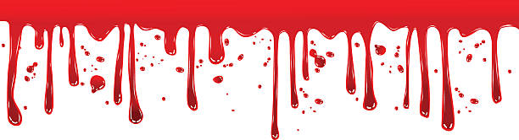
Nursing Management
Education & Discharge Teaching
Lifestyle/Safety: Keep all follow up appointments with provider!!
Anticoagulant Safety: take as prescribed & do not stop without speaking to your provider, caution with supplements and NSAIDs as they can increase bleeding risk, use soft toothbrush, consider an electric razor, caution with sports/activities that risk injury especially head injury INR monitoring & keep consistent Vitamin K intake if on Coumadin
Bleeding Risk: Monitor for signs of bleeding including blood in stool/urine, black tarry stools, coughing or vomiting blood, excessive bruising, nosebleeds, bleeding gums
Intracranial Bleed Risk: Especially with falls/head injury. Sudden severe headache, vision changes, weakness, confusion signs of brain bleed → → seek immediate treatment in ER.

Slide 26
THANK YOU ♥ CHRISSY

